Slide 1
Working principle of Barcode reader.
Md. Fazle Rabbi
ID:16CSE057

Slide 2
Presentation Outline
Introduction
Component of Barcode Reader
Types Of Barcode Scanner
How Does A Barcode Scanner Work?
Application of Barcode Scanner

Slide 3

Introduction
Barcodes are codes that contain data or information about a particular product.
Consists of black and white spaces.
Different letters and numbers are encoded using bars of varying lengths and width.
An optical scanner that can read printed barcodes, decode the data contained in the barcode and send the data to a computer.

Slide 4
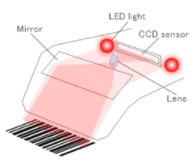
Component of Barcode Reader
Consists of the following components
Light source – Illuminates the barcode for proper reading.
Lens – Scans the barcode image.
Photo conductor – Translates optical impulses into electrical ones.
Decoder – Analyzes the data and sends the content to the scanner’s output port.
A decoder can be internal or external.

Slide 5


Types Of Barcode Scanner
1D Code :
2D Code
Linear black and white gaps of different widths.
Carry only alphanumeric data.
90% of applications use the 1D Code
Data like matrix and QR Codes, use hexagons, squares,
or other shapes to store data.
Arranged in both horizontal as well as vertical patterns.
Can hold up to 100 characters and thus store much more information

Slide 6

How Does A Barcode Scanner Work?

Slide 7

How Does A Barcode Scanner Work?

Slide 8
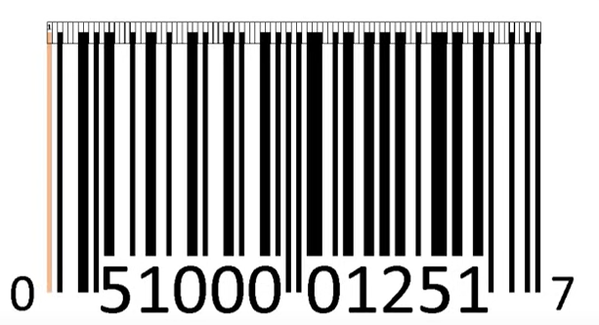
How Does A Barcode Scanner Work?

Slide 9

How Does A Barcode Scanner Work?

Slide 10

How Does A Barcode Scanner Work?

Slide 11

How Does A Barcode Scanner Work?

Slide 12
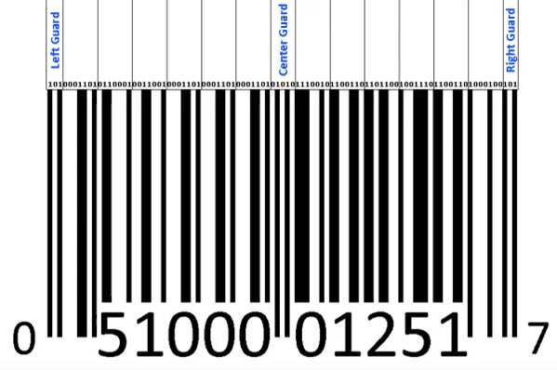
How Does A Barcode Scanner Work?

Slide 13
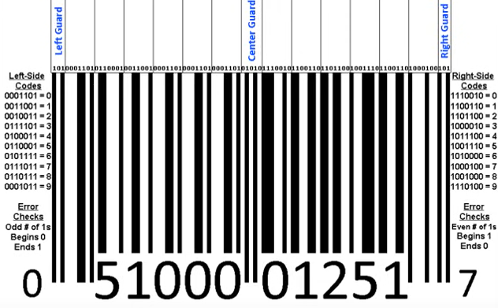
How Does A Barcode Scanner Work?

Slide 14
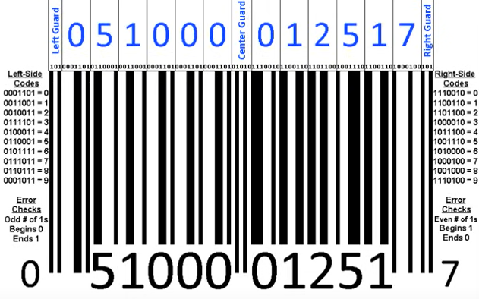
How Does A Barcode Scanner Work?

Slide 15
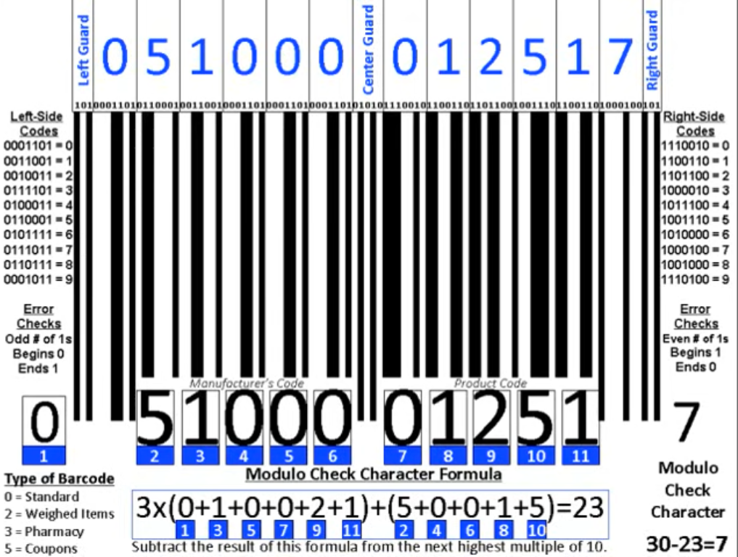
How Does A Barcode Scanner Work?

Slide 16
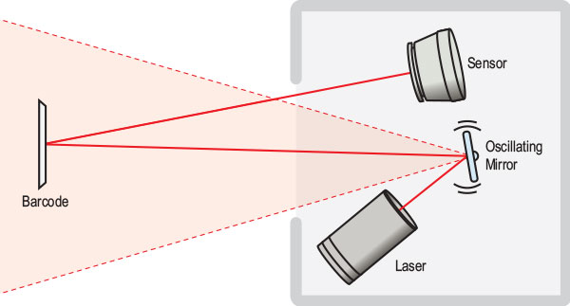
Types of Barcode Scanner
Laser Scanners
Use a laser beam as the light source.
Either a rotating prism or a reciprocating mirror scans the laser beam.
Photodiode measures the intensity of light.
Figure 1.4: Laser Scanners

Slide 17
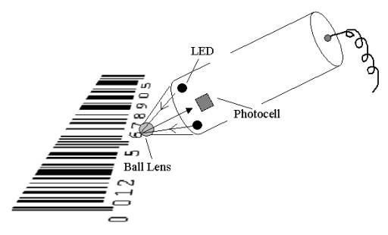
Types of Barcode Scanner
Pen-Type Readers
Light source and a photo-diode are placed next to each other at the tip of a pen-like device.
Move the tip of the pen across the bars
Photo-diode measures the intensity of the light and create a waveform.
Figure 1.5: Pen-Type Readers

Slide 18
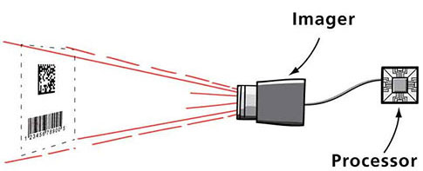
Types of Barcode Scanner
Camera-Based Readers
Two-dimensional imaging scanners.
Use a camera and image-processing techniques.
Figure 1.5: Camera-Based Readers

Slide 19
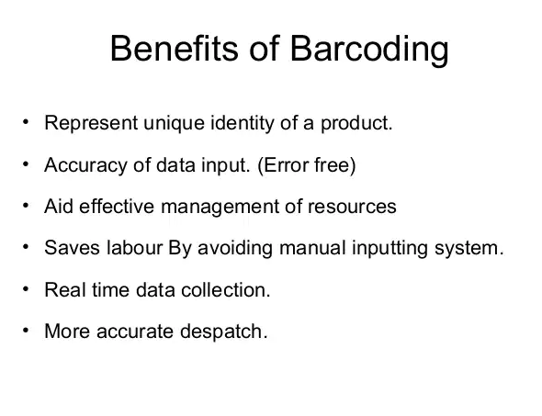

Slide 20
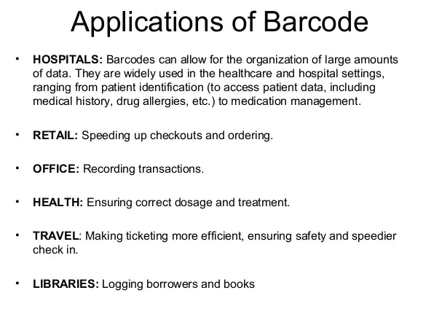

Slide 21
THE END

